Slide 1
Cross Joins and Pivot Functions
Advanced SQL for Analysts

Slide 2
agenda
Joins
Join types
Cross-joins
Anti-joins
Non-equi joins
Other
Pivot functions

Slide 3
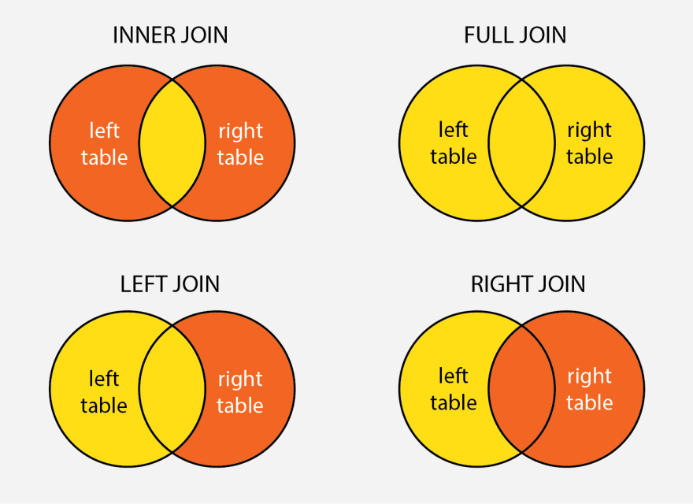
Standard join types
These are standard join types.
They will be sufficient in most cases.
Just a note that you don’t necessarily need both left and right joins. Try and use just left joins.
The main requirement is that data must be present in both tables for them to work.
What if that’s not the case?

Slide 4
examples
You need to calculate a percentage where not all values are present in the data.

Slide 5


